Slide 1
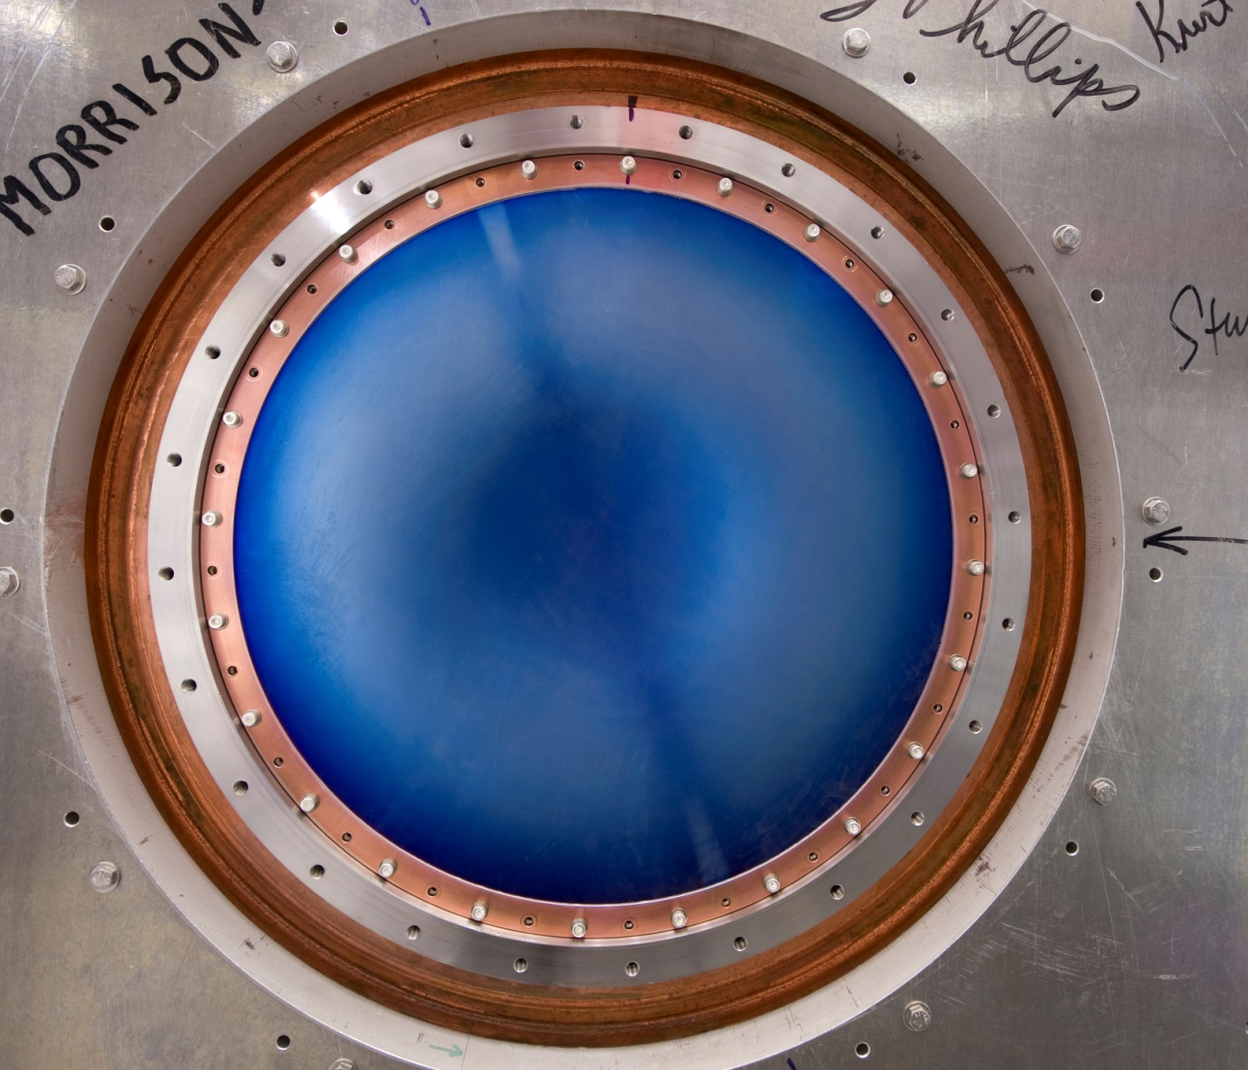
Muon Collider R&D: Status and Opportunities to Participate
MuCool
MICE
6DICE
& Hardware
Vladimir Shiltsev with input from Alan Bross

Slide 2
Let’s Set Up The Stage
ILC: 0.5TeV, 36 km of accelerators, 16B$, 230 MW
24,000 elements for individual control… feasible
CLIC: 3TeV com, ~60 km, 15-20B$, 568 MW
Some 220,000 elements to control, TBA… feasible?
Alternatives on the table:
No need in a lepton collider if LHC detectors are smart
Plasma Accelerator (!! 1TeV ?@*! 2040 !&%!?!) …or
Muon Collider: 2-4TeV, 14-20 km of accelerators, fits FNAL site, XB$, 120-200 MW, Neutrino factory
~6,000 elements feasible? – depends on luminosity

Slide 3
Luminosity ~1/beamsize^2
3TeV

Slide 4
The Greatest Challenge for Future Muon Accelerator Facilities
In order to fully utilize the intense source of muons that can be produced at a multi-megawatt target facility, the muon beam must be “cooled”
Provides potential 1-2 orders of magnitude increase in sensitivity for future cLFV experiments
Greatly improves the performance of the Neutrino Factory
Is absolutely needed for an energy-frontier, high-luminosity Muon Collider

Slide 5
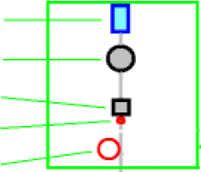
Muon Collider Scheme: 7+ machines
4D cooling
6D cooling
FOFO Snake*
Guggenheim
HCC
Phase rotation
to 12 bunches
Merge 12
to 1 bunch
20T capture
Hg target
6D cooling
Buncher
50T solenoids*
REMEX
Li lenses
Multi-MW
Proton Driver
SC linac
Synchrotron
both
Final cooling
Linac
RLA(s)
RLA*
Pulsed
synchrotron*
FFAG
High Energy
Acceleration
“Front End”~ same as for Neutrino Factory →
Idea of staging
Collider Ring

Slide 6
Compare with Tevatron: 4 out of 7 machines for pbars

Slide 7
9 Stages of Muon Cooling: the most important kilometer

Slide 8
Where and How Can Experimentalists Contribute?
Theory (beam dynamics)
Many issues are complicated.. even for accelerator pro’s
Still, there are some opportunities..require some learning
Design and simulations
There are many codes developed which can provide input needed for the MC/NF design
Experimental program
MuCool, MICE and 6DICE (see below)
Hardware development
SC magnets, RF (NC and SC), targets, etc

Slide 9
Fermilab Program
MuCool (ongoing)
Study the effects of magnetic field on high-gradient normal conducting RF cavities
Find a solution to the current problem of degraded RF cavity performance when operated in an external magnetic field.
MICE (ongoing)
To build and operate a realistic section of a cooling channel, as might be used in a Neutrino Factory.
To measure the muon into and out of the cooling channel and measure a 10% reduction in emittance of the beam with a precision of 1%, and experimentally demonstrate ionization cooling
6DICE (prepare for >2016)
To build and operate with beam of muons a realistic section of a 6D cooling channel, as might be used in a Muon Collider

Slide 10
Normal Conducting RF R&D Issues for MuCool
Muon bunching, phase rotation and cooling requires Normal Conducting RF (NCRF) that can operate at “high” gradient within a magnetic field strength of up to approximately 6T
Required gradients (15-18MV/m) easily obtainable in absence of magnetic field
And since we are primarily considering pillbox structures, 15-18MV/m is also the max surface gradient

Slide 11
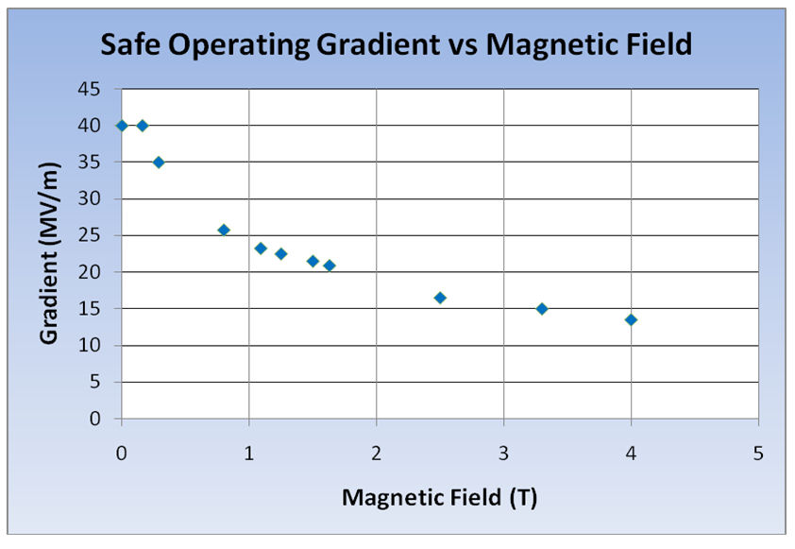
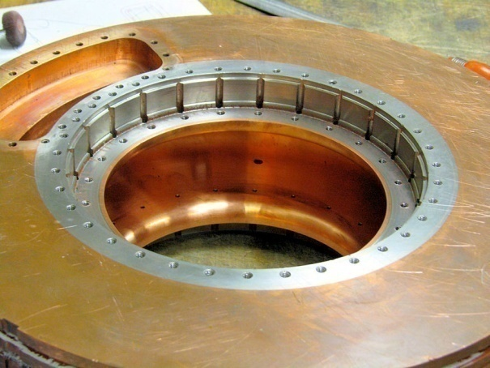
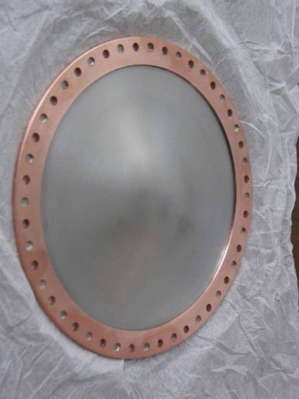
“Our” RF Challenge
Significant degradation in maximum stable operating gradient with applied B field
805 MHz RF Pillbox data
Curved Be windows
E parallel B
Electron current/arcs focused by B
Degradation also observed with 201 MHz cavity
Qualitatively, quite different

Slide 12
RF Breakdowns
Are not all equal
NCRF conditioning (B=0), process allows for higher gradient operation (“conditioning”)
Both our 805 MHz and 201 MHz test cavities followed the conventional wisdom here
NCRF (B ≠ 0), process can cause damage and require re-conditioning at lower gradient in order to reach the same gradient attainable before breakdown

Slide 13
The MAP/MuCool NCRF Program R&D Strategy
Technology Assessment (continuation of existing multi-pronged program & explore new ideas)
Surface Processing
Reduce (eliminate?) surface field enhancements
SCRF processing techniques
Electro-polishing (smooth by removing) + HP H₂O rinse
More advanced techniques (Atomic-Layer-Deposition (ALD))
Smooth by adding to surface (conformal coating @ molecular level)
Materials studies: Use base materials that are more robust to the focusing effects of the magnetic field
Cavity bodies made from Be or possibly Mo
Magnetic Insulation
Inhibit focusing due to applied B
High-Pressure Gas-filled (H₂) cavities
Vacuum

Slide 14
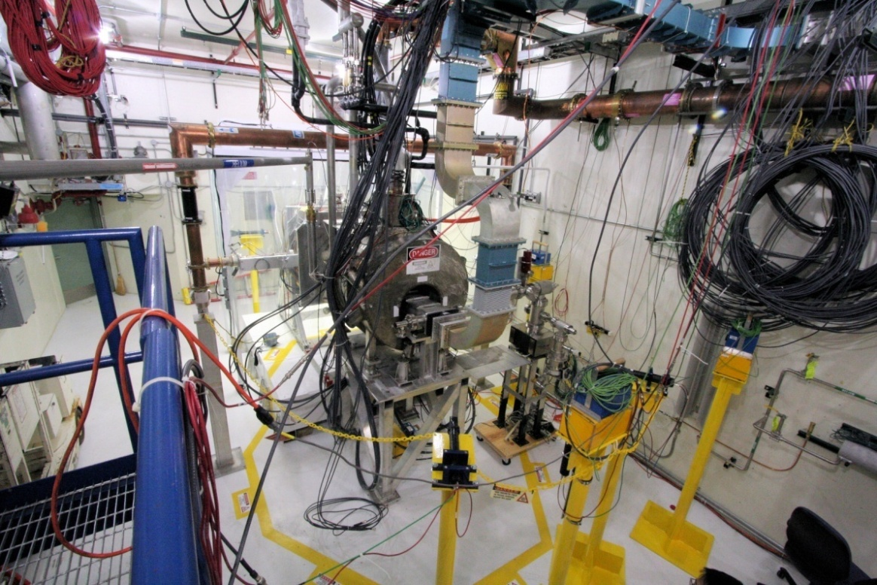
MuCool Test Area (MTA)
MuCool Test Area (MTA)
RF power
201 MHz (5MW)
805 MHz (12 MW)
Class 100 clean room
4T SC solenoid
250W LHe cryo-plant
Instrumentation
Ion counters, scintillation counters, optical signal, spectrophotometer
400 MeV p beam line

Slide 15
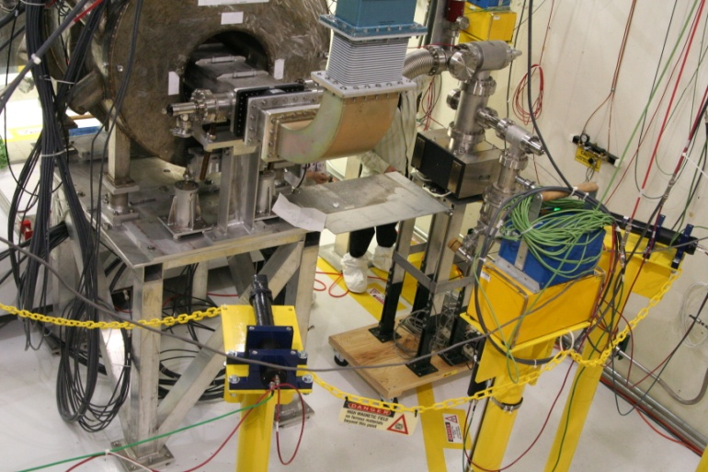
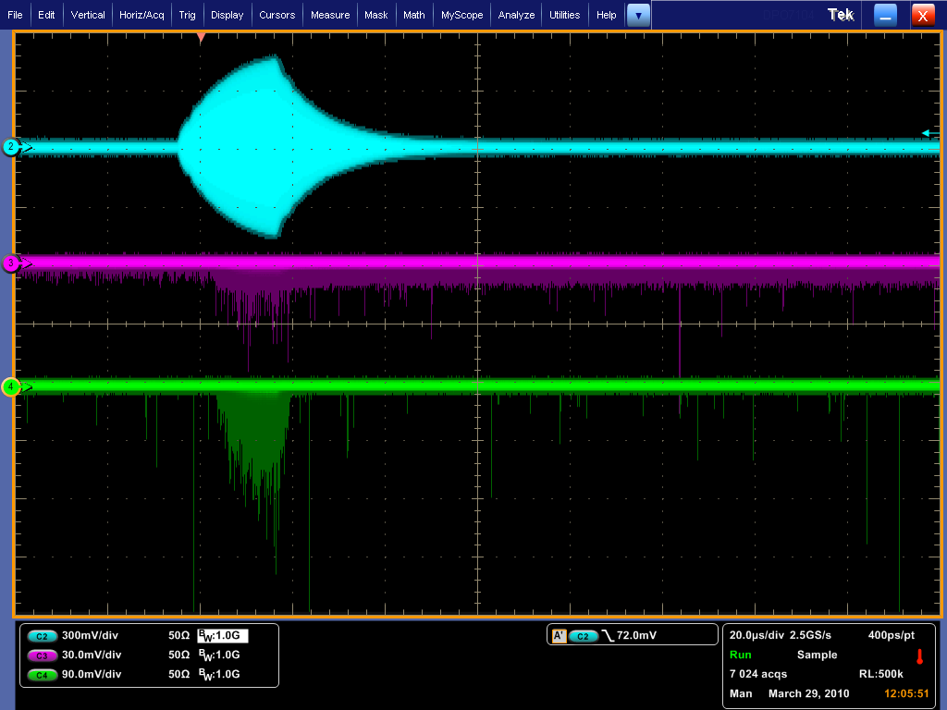
MTA Instrumentation
Optical Diagnostics
Counters
RF Pickup
X-ray
Optical
Acoustic diagnostics
Planning to explore utilizing acoustic “imaging’
use instrumentation developed for COUPP
DAQ

Slide 16
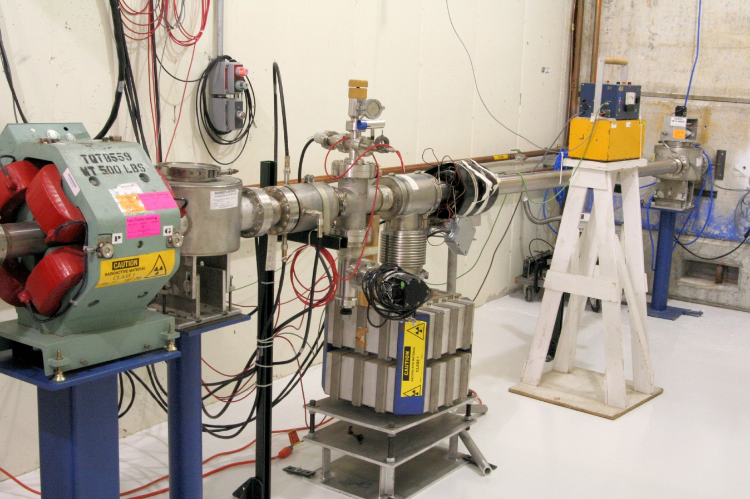
MTA Beam Line Status
Beam Line Installation
Complete
Beam Line commissioning to first beam stop.
Complete
Radiation and safety assessments approved
First beam experiments by March
The MTA is a World-Class Facility (& Unique):
High-Power RF; High-Intensity Beam; H₂ handling, SC Magnet

Slide 17
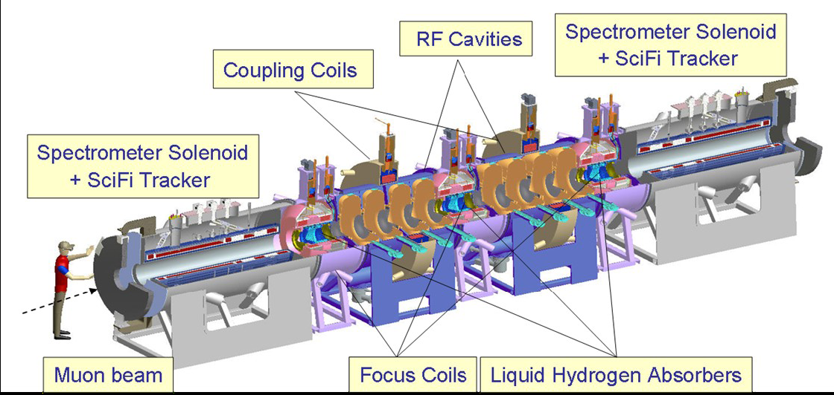
MICE
Muon Ionisation Cooling Experiment
Design, build and operate a realistic section of cooling channel
Measure its performances (in different modes)
Notes:
MICE stands for Muon Ionisation Cooling Experiment
The main goal of the experiment is to Design, build and operate a realistic section of cooling channel and
Of course to measure its performances in different conditions.
Here you see a 3D cut view of the experiment where you can recognize the elements I have already mentionned
The 200 MHz RF cavities
The liquid Hydrogen absorbers
The superconducting coils, for focusing on the absorbers and for ensuring the continuity of the magnetic channel
And also, before and after the cooling section, two spectrometers that allow measuring precisely, the position and the momentum of the beam, particle by particle, so that we can compute the covariance matrix that will give us the emittance, before and after, and therfore the cooling effect.
But we are not at this stage yet.
1’30’’

Slide 18
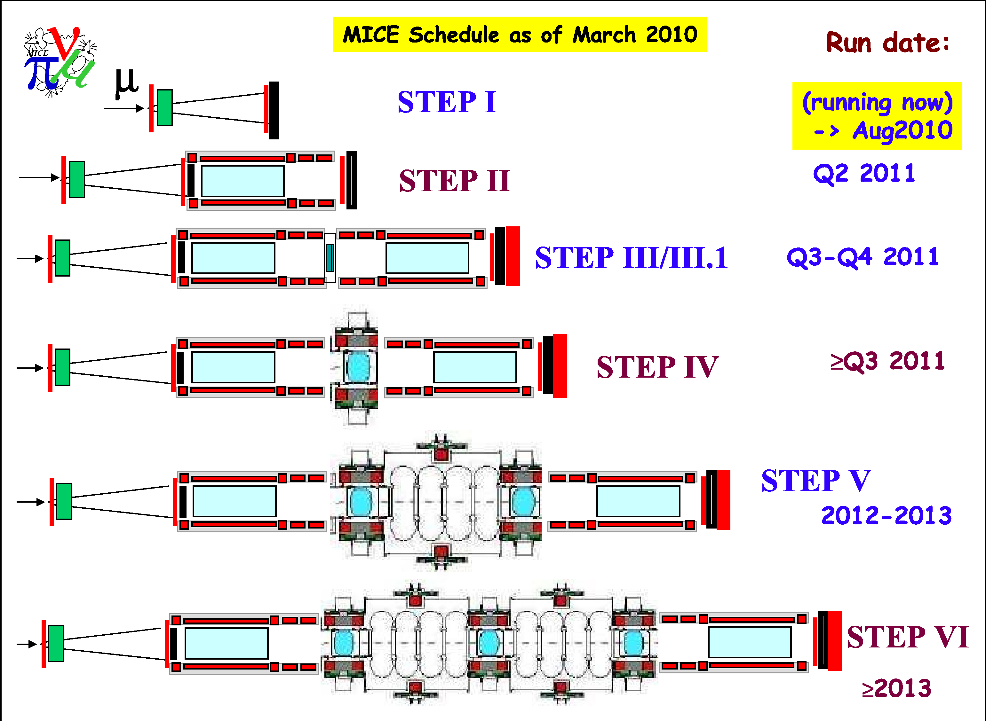
MICE Step By Step
Commission beam
line & detectors
Precisely measure
incoming emittance
& compare trackers
Precisely measure
muon cooling
Test sustainable
cooling
Ultimate MICE
goal: operate 1 full cell
of cooling channel
2012
Notes:
Cause MICE had to start from scratch in 2004 and
For now we have just completed the first step which is the commissioning of the muon beam line and the so called particle identification detectors
that I will present in more details in the rest of my talk.
The next step will actually be the installation of the spectrometers allowing the precsise measurement of the emittance of the beam and the comparison of the two trackers.
Then we’ll be ready to install the first Liquid hydrogen absorber. Technically this will allow the first measurement of a cooling effect but this would not be sustainable since the energy is not restored.
This will be possible only in 2013 when the first set of RF cavities should be delivered and installed.
And the last absorber, and the second set of cavities should arrive at best at the end of 2013 to complete the set up so we can operate the full cooling cell.
1’10”

Slide 19
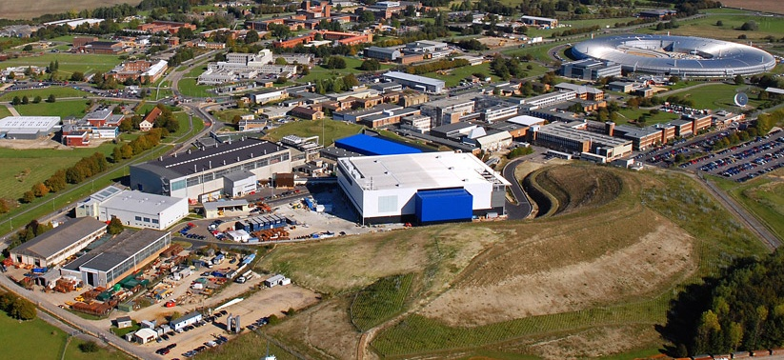
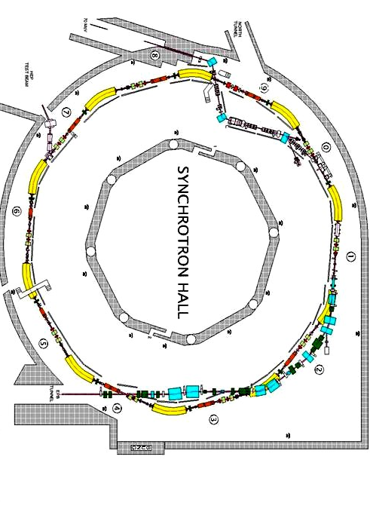
MICE Status @ RAL
Rutherford Appleton Laboratory, UK
Brand new muon beam line
Obtained from ISIS (800 MeV proton Synchrotron)
Notes:
Now I will focus on the status of the experiment which is hosted at the Rutherford Appelton Laboratory in the UK, near Oxford, and
Using a brand new muon beam line obtained from the 800 MeV proton Synchtron named ISIS.
But In order to present the most recent results I have first to introduce in more details the MICE beam line and its instrumentation.
30 ’’
13’20’’

Slide 20
Instrumentation for Step 1
All detectors for Step 1 are operational TOF0 after the 2nd triplet
TOF1 after the 3rd triplet
TOF2 at the very end (will move)
Beam Profile Monitors
Fermilab responsibility

Slide 21
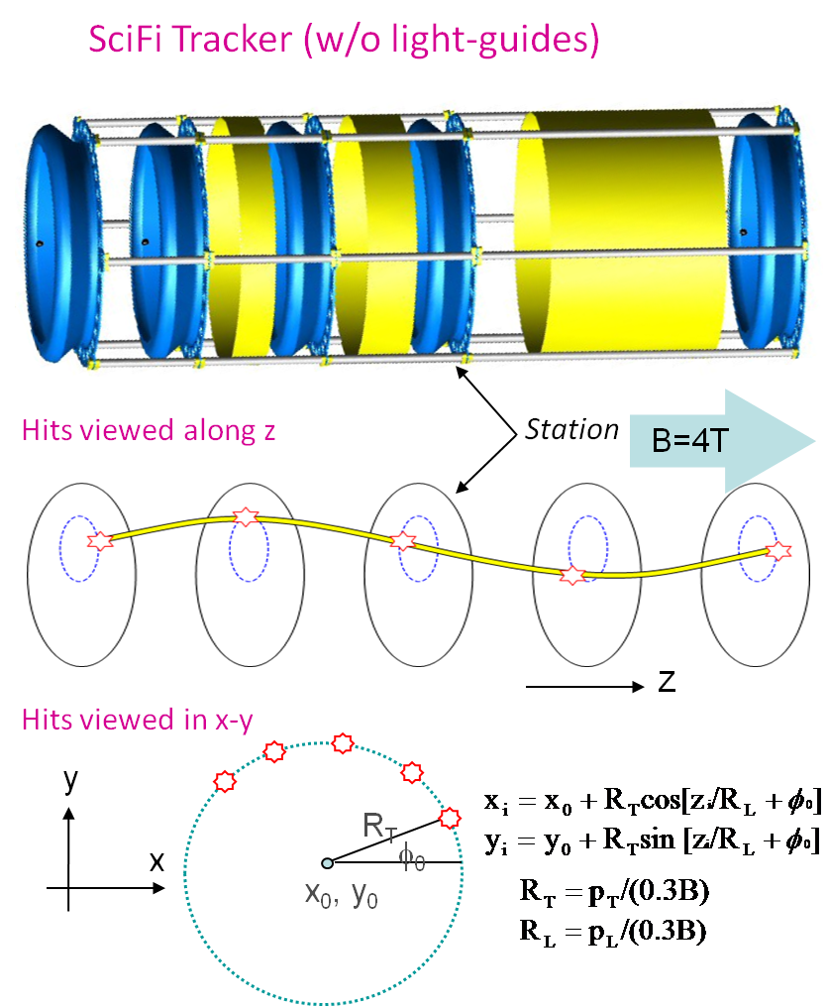
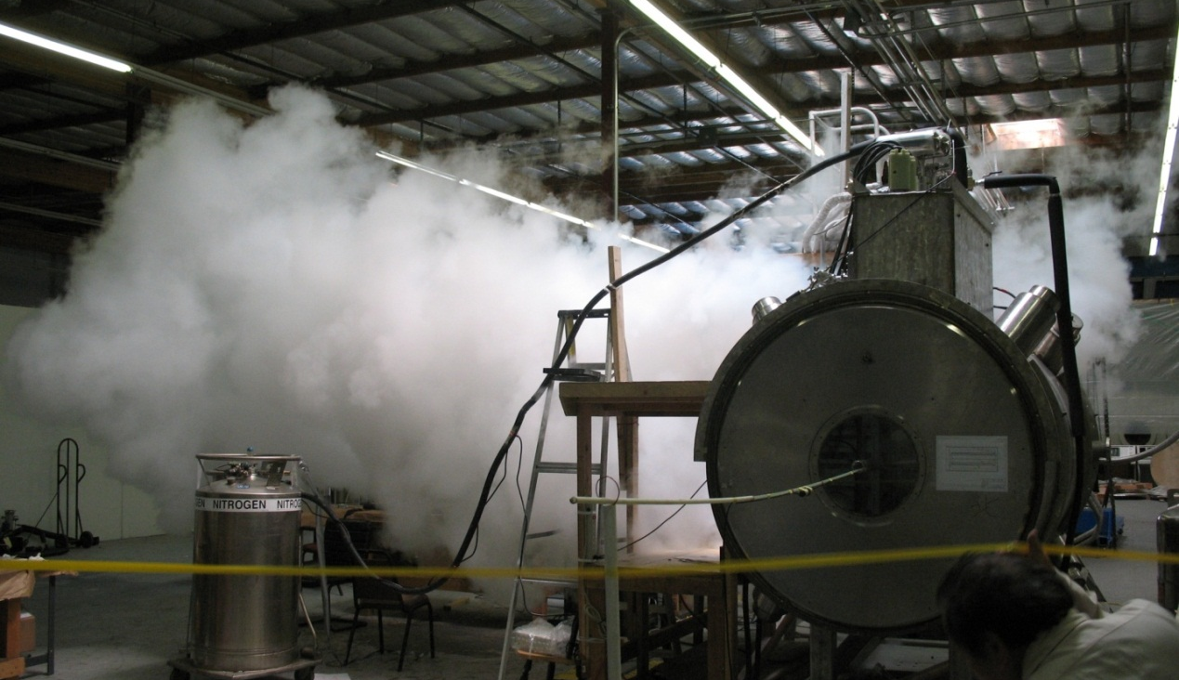
Next Step: Spectrometers
Construction problems with the superconducting solenoids
Tracker Ready, tested with cosmics, meet resolution specs
Installation scheduled for 2012
Tracker modeled after D0 CFT
Major Fermilab responsibility
Notes:
So it’s a bit ironic, but
I don’t have much time left for future.
I just want to tell you that the next step is the installation of the spectrometers.
And we had serious technical problems with the spectrometer solenoid magnets
And unfortunately we could not replace them with permanent magnets at the last minute…
so they had to be partially redesigned after a first failure during the power test.
So the installation had to be postponed to next year but in the meanwhile the scintillating fiber trackers, that should go inside,
Have be completed and tested with cosmic rays (and no magnetic field ) and they meet all the specifications on spatial resolution
so we don’t expect additional problem on that side.

Slide 22
6D Ioniz Cooling Demo Strategy
MICE is both technology demo and beam experiment at the same time
Assuming MICE is successful in demonstrating transverse muon cooling and emittance exchange, our assessment is that most of the technical risk is related to remaining untested 6D cooling technology (i.e. can we build and operate the channel as designed).
Separate bench test tech demo from beam test for 6D cooling!
Only bench test will actually be carried out during the 7-year MAP programme:
Show that the cooling channel design can be implemented in practice, and operated within its design parameters.
No beam is needed for such a bench test demonstration.
In addition - develop plans for a 6D cooling experiment(6DICE)

Slide 23
6DICE Experiment Strategy
To arrive at an optimal experimental setup, we need to carry out
A simulation effort to understand what aspects of the cooling channel performance need to be tested, and to what accuracy. This will include determining the required length of cooling channel, the required beam parameters, and the analysis approach.
A diagnostics/detector effort to determine how best to measure the muon beam to the required accuracy.
A design/integration effort to specify, and define a layout for, the experiment. This will be coordinated with the bench test activity, to ensure to the extent possible that the cooling channel hardware built for the bench test can also be used for a beam test.
Many details undefined until baseline channel has been selected.
reduction of 6D emittance by a factor of 5 (1.7 per plane) requires ~60 m of the 6D channel

Slide 24
Possible Muon R&D Facility in KTeV Hall
~120 m long: 35m x4x3m + 40m x7x6 m + 45m x17x12m
120 GeV, 3-8ns short bunches from Main Injector with N_p=(1-40)e10/bunch – already available
Control room and PS areas; 25-ton crane, water, lots of electric power available

Slide 25
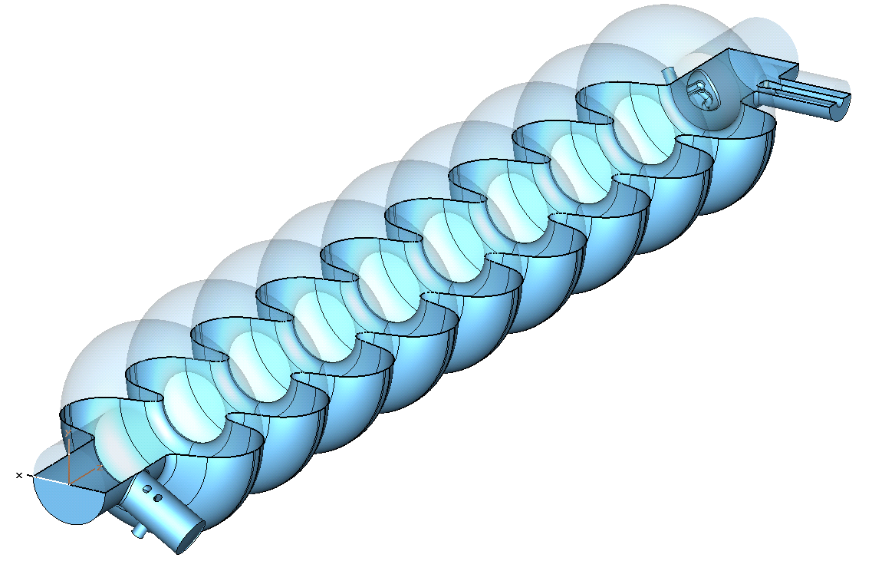
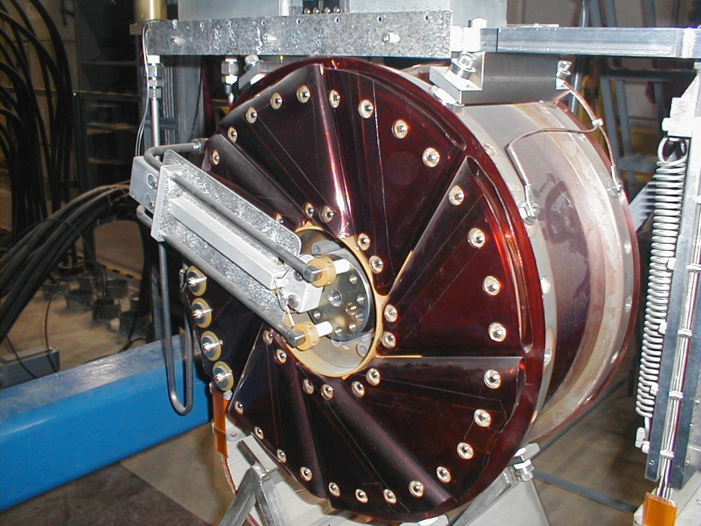
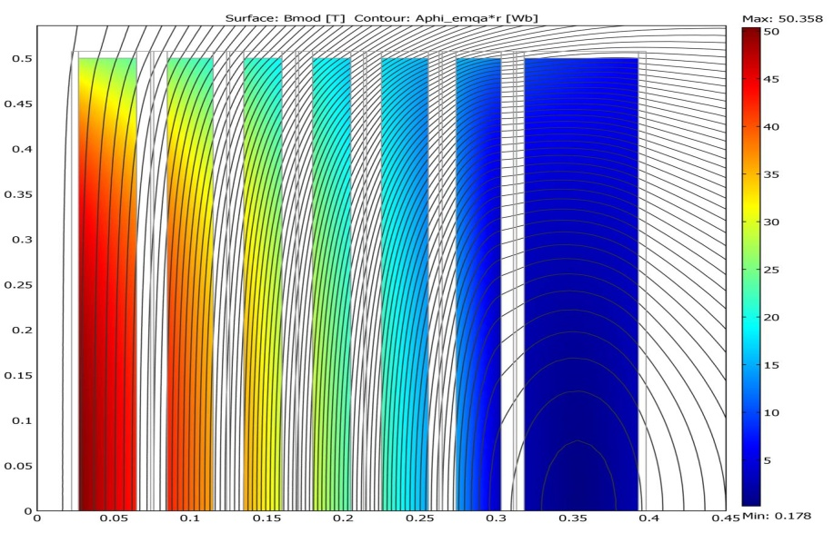
Hardware Development
SC coils 3-7 T
HTS 50 T solenoids
Fast-ramp magnets
Open mid-plane Ds
4MW Proton target
H2 LiH μ absorbers
Liquid Li lenses
NC RF for Cool
Induction Linacs
NC RF for accel
SC RF for accel, …
Notes:
So it’s a bit ironic, but
I don’t have much time left for future.
I just want to tell you that the next step is the installation of the spectrometers.
And we had serious technical problems with the spectrometer solenoid magnets
And unfortunately we could not replace them with permanent magnets at the last minute…
so they had to be partially redesigned after a first failure during the power test.
So the installation had to be postponed to next year but in the meanwhile the scintillating fiber trackers, that should go inside,
Have be completed and tested with cosmic rays (and no magnetic field ) and they meet all the specifications on spatial resolution
so we don’t expect additional problem on that side.

Slide 26
Summary
Muon Collider is a complex project
not as much as CLIC or plasma… closer to the Tevatron
There are many opportunities for you to contribute:
MuCool - an experimental program aimed at developing a solution to our “RF Challenge”
now coming on strongly, entering a new exciting phase
MICE is exploring muon ionization cooling which is a key R&D step towards future muon facilities
muon beam and the beam-line detectors are up&running
6DICE experiment and Hardware R&D need help, too

Slide 27
Back up slides

Slide 28
RF Operation in Vacuum 805 MHz Imaging
Hot Spot Arc forms
Cavity Energy
W=1/2 CV²
≈ 1-5 joule
All goes into melting Cu
B
Surface Field Enhancement
Initiates the event & B focuses the e⁻ current
which causes damage
28

Slide 29
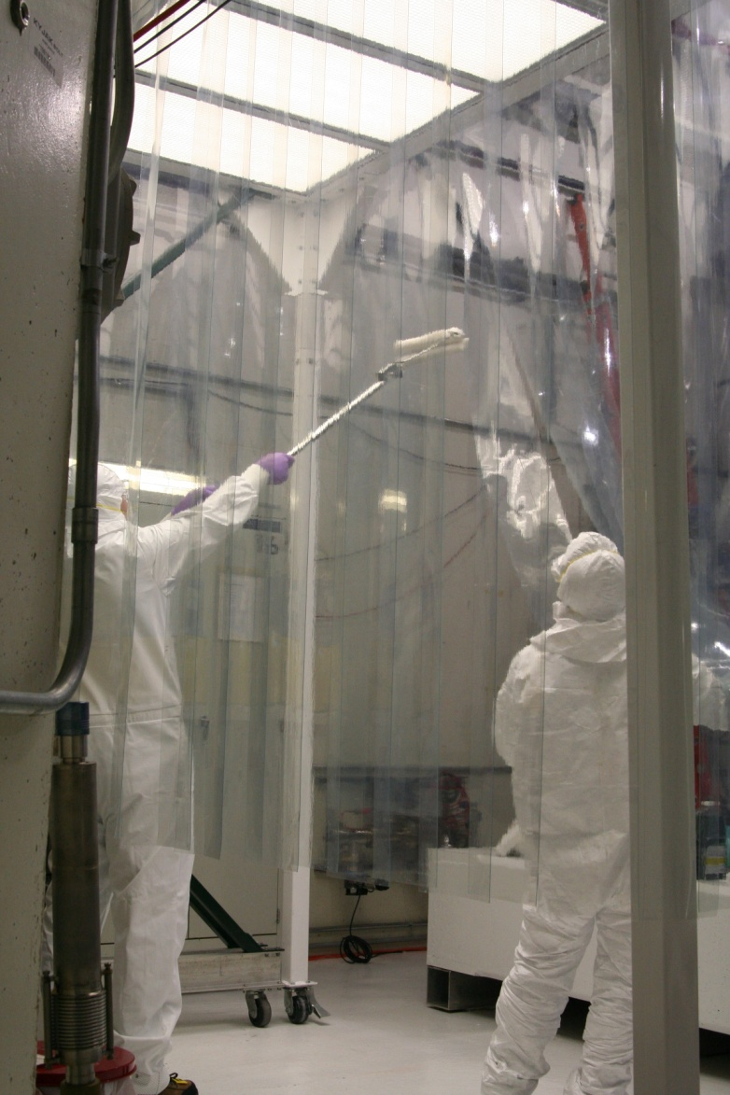
MTA Hall – Clean Room
Goal for Clean room : Class 100
Achieved better than Class 10
Even with 3 people inside: Class 40
Goal for Hall: Class 1000
Achieved Class 500

